Slide 1
Principles of Design
a- Minimum cost.
b- Minimum weight.
c- Minimum construction.
d- Minimum labor.
e- Minimum cost of manufacture.
f- Maximum efficiency of operation to owner.
Structural Requirements
The designer’s task of assessing whether or not a structure will satisfy the structural requirements of serviceability and strength.

Slide 2
ASD and LRFD Specifications
ASD: The AISC specification for ASD establishes allowable unit stresses that, under service loads on a structure, may not be exceeded in structural members or their connections.
LRFD: The AISC specification for LRFD requires that factors be applied to both service loads and the nominal resistance (strength) of members and connections.

Slide 3
Design philosophies
Design Strength < Required Strength

Slide 4
Load combinations in LRFD
LRFD- 1: 1.4D
LRFD- 2 : 1.2D + 1.6L + 0.5(Lr or S or R)
LRFD- 3 : 1.2D + 1.6(Lr or S or R) + (0.5L or 0.8W)
LRFD- 4 : 1.2D + 0.5L + 0.5(Lr or S or R) + 1.6W
LRFD- 5 : 1.2D + 0.5L + 0.2S ± 1.0E
LRFD- 6 : 0.9D ± 1.6W
LRFD- 7 : 0.9D ± 1.0E
.

Slide 5
Load combinations in ASD
ASD- 1: D
ASD- 2 : D + L
ASD- 3 : D + (Lr or S or R)
ASD- 4 : D + 0.75L + 0.75(Lr or S or R)
ASD- 5 : D ± ( W or 0.7E)
ASD- 6 : D + 0.75(W or 0.7E) + 0.75L + 0.75(Lr or S or R)
ASD- 7 : 0.6D ± (W or 0.7E)
.

Slide 6
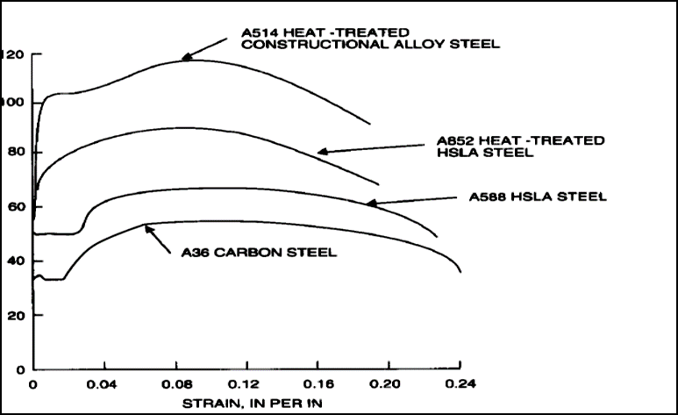
Structural Steel shape and plates

Slide 7
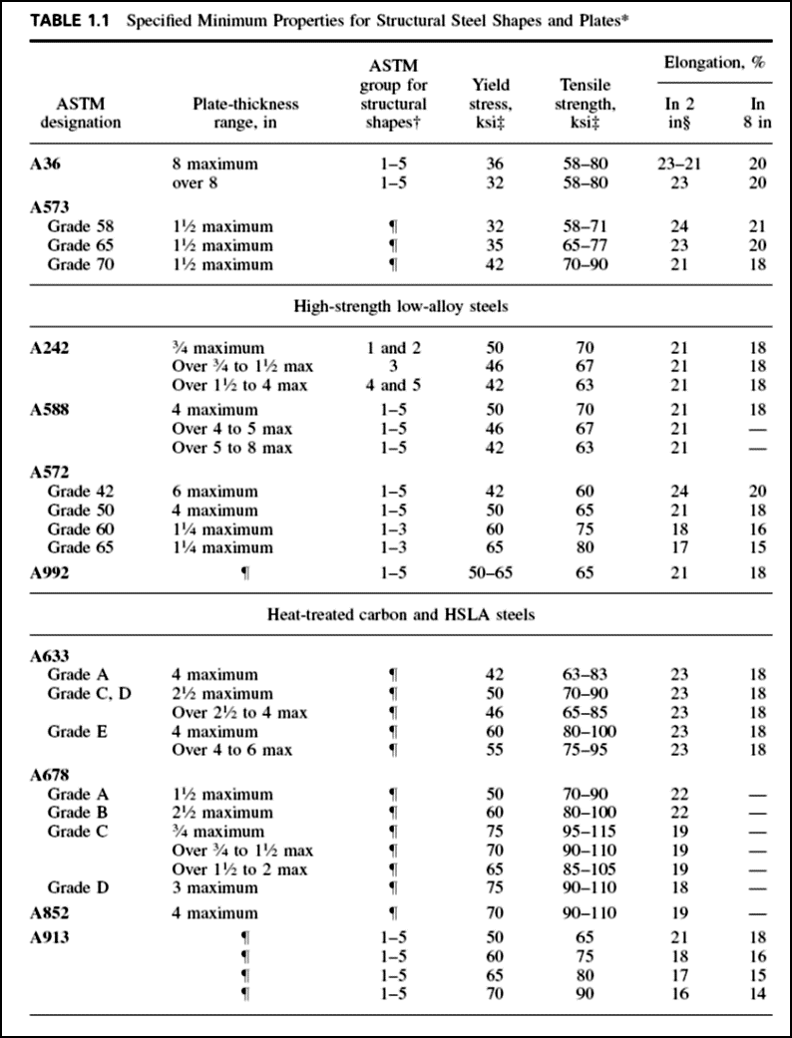

Slide 9
Mechanical properties under static load
Idealised stress–strain relationship for structural steel

Slide 10
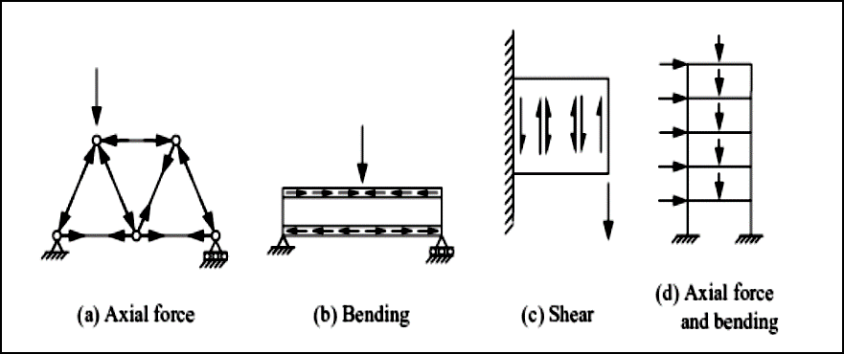
Structure behavior
The behavior of a structure depends on the load-transferring action of its members and joints. This may be almost entirely by axial tension or compression, as in the triangulated structures with joint loading as shown in Figure below:

Slide 11
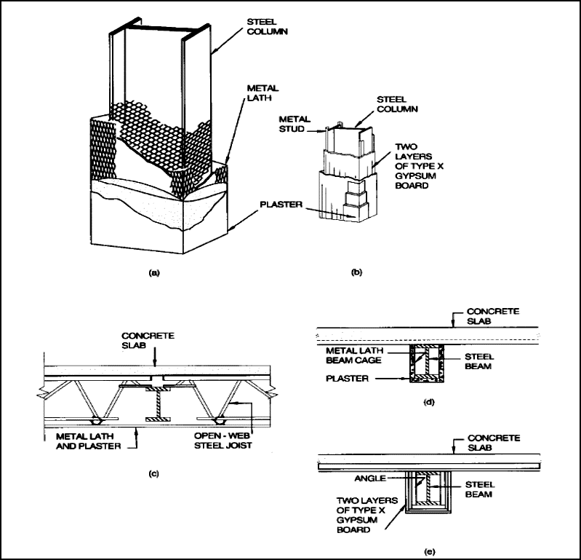
Fire-Resistant construction
Fire-Protection Materials
1. Gypsum
2. Spray-Applied Materials

Slide 12
THANKS FOR YOUR ATTENTION

